Slide 1
Frontend Developer
Presented By-Shivani Kumawat

Slide 2
What is Frontend?
JavaScript
HTML
CSS

Slide 3
Technologies Upgrade in React Js
React 18 | It helps websites and apps run smoother and faster.
React Refresh | Building websites easier and quicker.
Improved TypeScript Support | Helps developers understand and write code more accurately.

Slide 4
Career Aspiration
Continuous Learning and Growth
Freelancing

Slide 5
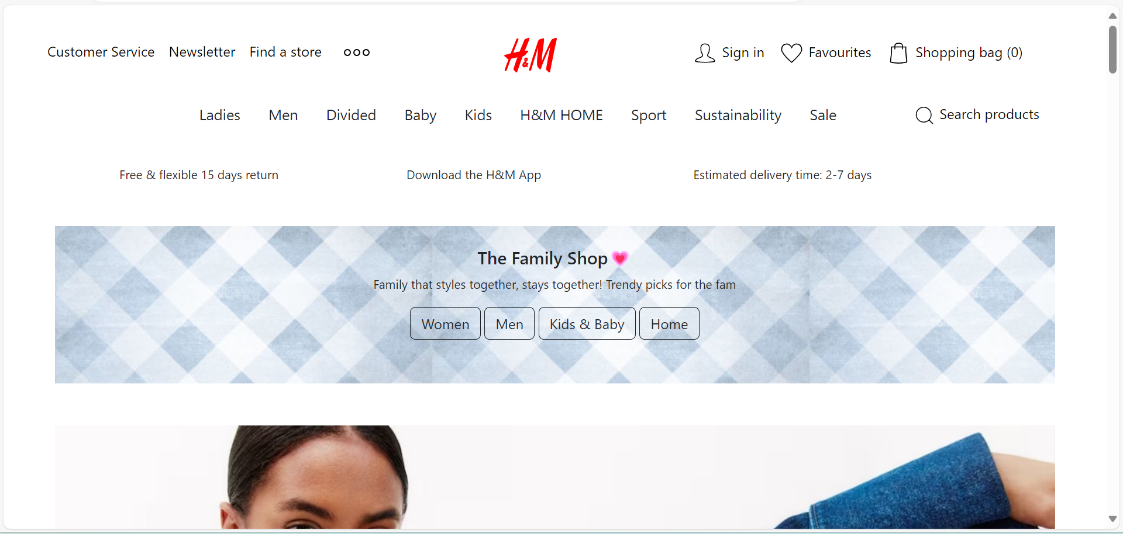
Projects
Responsive Clone Site(H&M)
Using HTML, CSS and Bootstrap

Slide 6
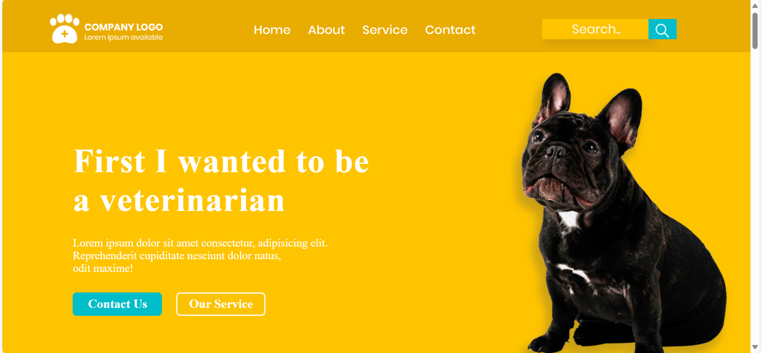
Projects
PSD to HTML
Using HTML, CSS and
Media Query

Slide 7
Why Did I Choose IT field
Remote Work Opportunities
Job Security
Continuous Learning

Slide 8
Why Did I Choose Frontend
02
01
Creativity
Quick Results

Slide 9
Thank You!

